Slide 1
What is CRM ?
Customer Relationship Management (CRM) systems offer tools to efficiently manage the sales and marketing functions of the organization.
Typical CRM applications will include functionality for quote and proposal management, prospect and customer tracking, commission plans, promotions, campaign management, knowledge base, and product configuration.
Larger systems may also offer capabilities for service call management, field service, forecasting, and analysis.

Slide 2
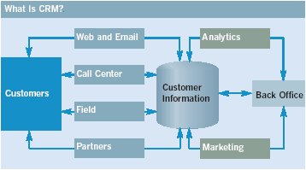
What is CRM?
An integrated approach to identifying, acquiring and maintaining customers.
Allows companies to coordinate their approach across channels, departments and also geographically.

Slide 3
Why to Invest in CRM in a Tough Economy?
Maximize your return on your company’s investments in sales, service, and marketing
Maximize the value of every existing customer relationship
Drive real-time visibility of all customer-facing processes

Slide 4
Microsoft Dynamics CRM
Microsoft Dynamics CRM is a fast, flexible, and affordable solution; for driving consistent and measurable improvements; in customer relationship management
Hosted and Managed by Microsoft
Part of Microsoft’s multibillion dollar investments in global data centers.
xRM is a Microsoft Partner specializing in Dynamics CRM customization, integration, and training to customers throughout the United States.

Slide 5
Vision of Microsoft Dynamics CRM
Uniting people and technology to deliver amazing customer experiences
Technology plays an important role enabling a business to connect their people, with their suppliers and most importantly with their customers.
Microsoft Dynamics energizes and empowers these connections with real time information and collaboration.

Slide 6










Microsoft Dynamics CRM Not just account / contact management
Sales
Service
Marketing
Complete CRM Suite
Sales, Marketing, Service
Activity Tracking
Rich Reporting, Analytics
Rich Platform
Deep process automation
Easy configuration and customization
Extensible architecture
SDK + Web Services

Slide 7
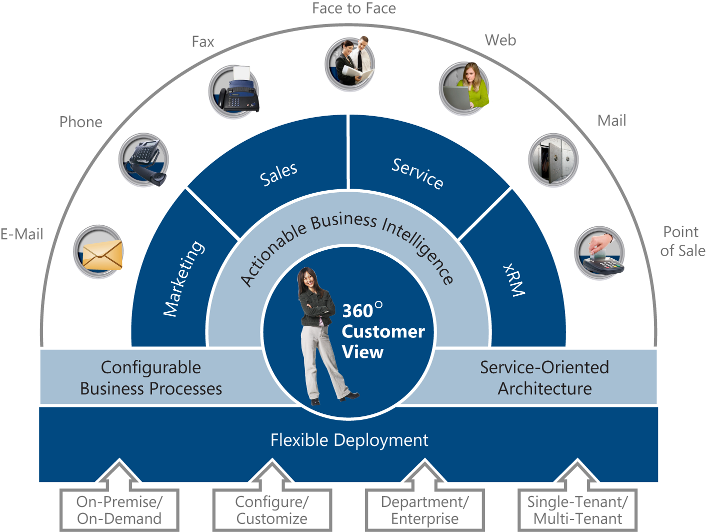
Microsoft Dynamics CRM Suite
Full CRM suite capabilities and application flexibility
Interactions
Marketing
Sales
Service
xRM
Business Process
SOA
Flexible Deployment

Slide 8
Microsoft Dynamics CRM Technologies
Microsoft CRM integrates and works with the following technologies
Microsoft CRM
.NET Technologies
Internet Information Server(IIS)
Active Directory
SQL Server & SRS
Microsoft Exchange*

Slide 9
Useful Links and Resources
Learn more about CRM
http://crm.dynamics.com (customer-facing)
http://www.microsoft.com/dynamics/crm/default.mspx (customer-facing)
https://mbs.microsoft.com/partnersource/ (partner only)
http://www.microsoft.com/downloads/ (search “Dynamics CRM”)
http://microsoft-crm-au.spaces.live.com/ (Dynamics CRM in Australia BLOG)
Australian Dynamics CRM 4.0 Product Info on Windows Live Skydrive
http://citizenserviceplatform.com/default.aspx

